Slide 1

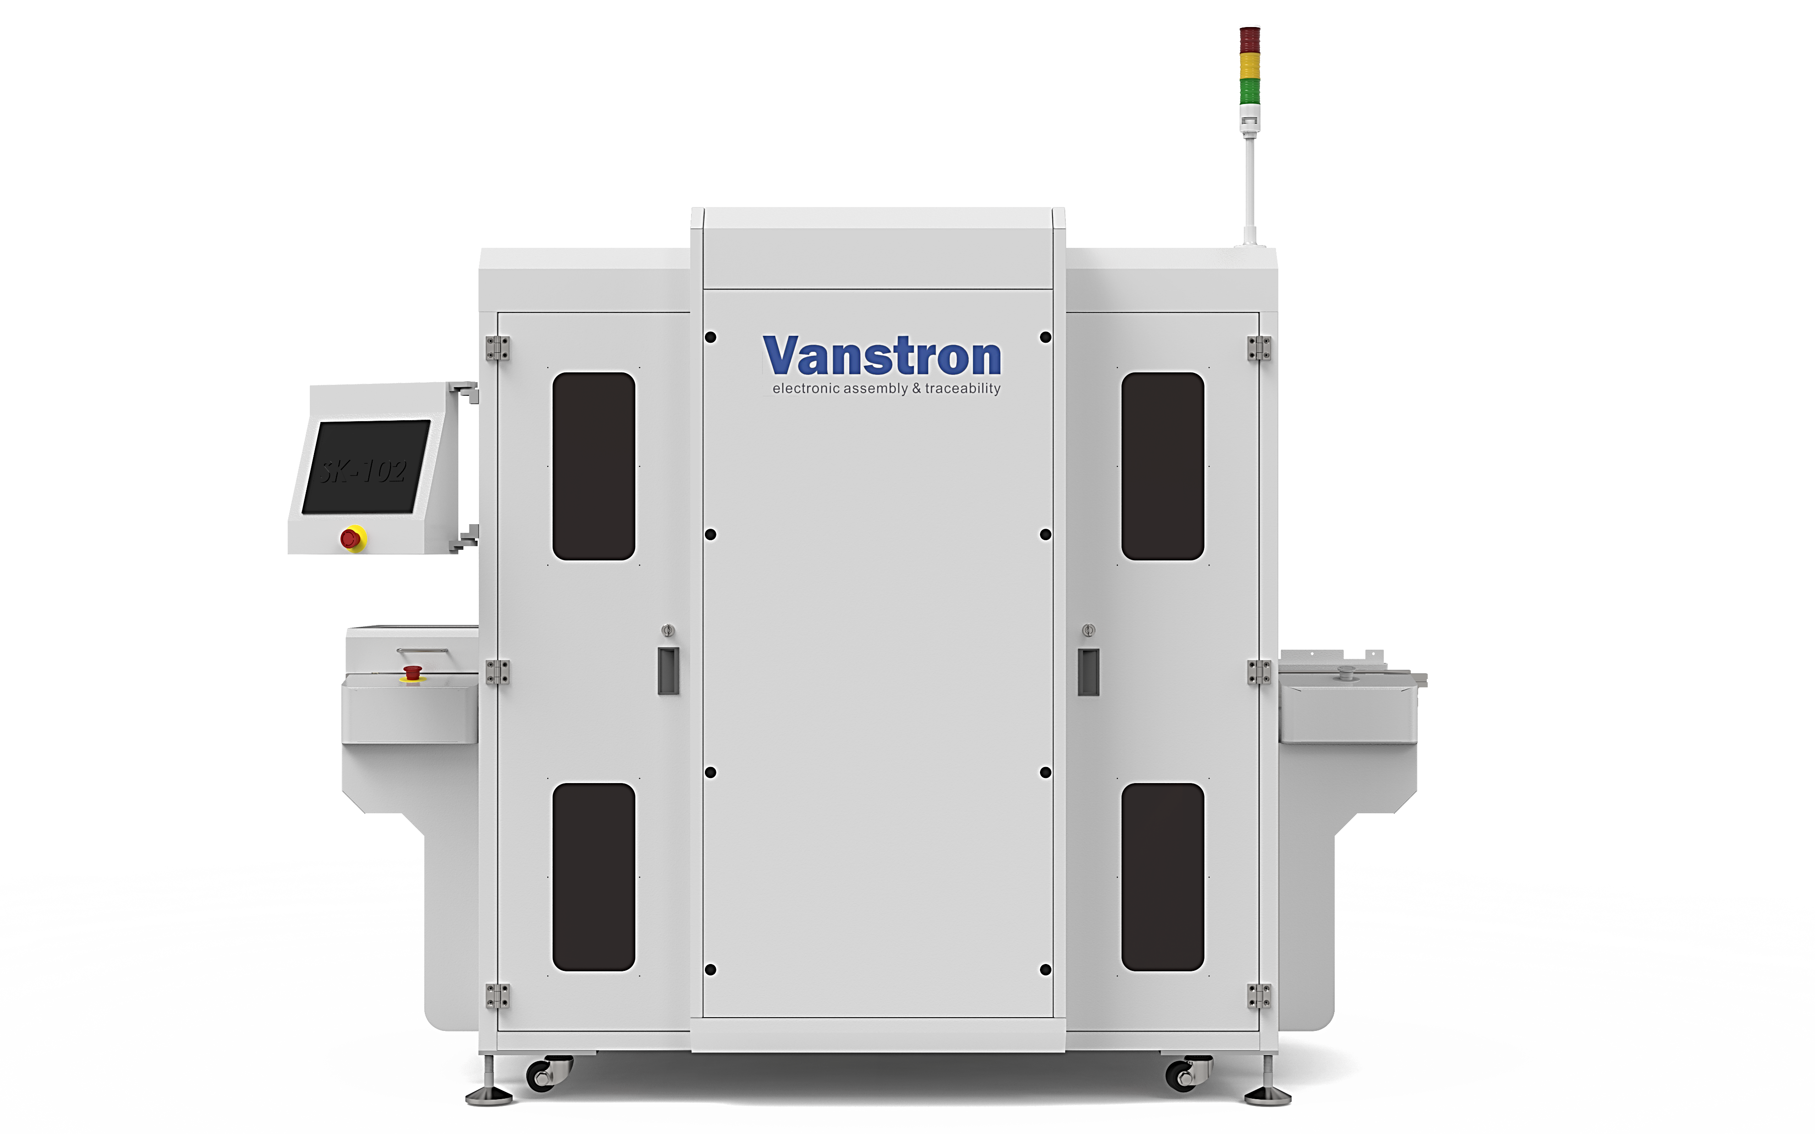
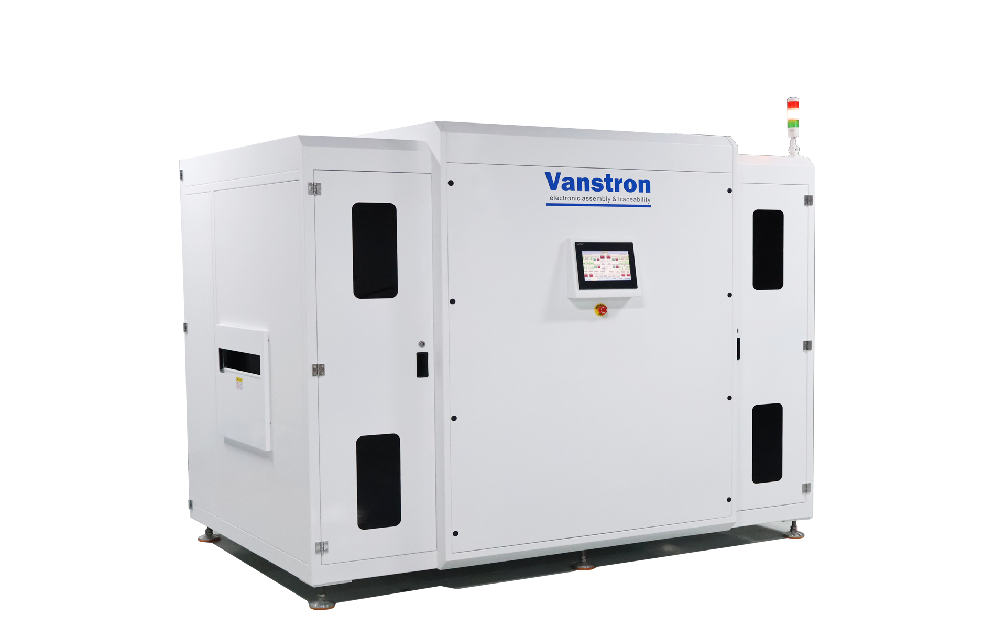
Inline
Vertical heating oven
Special for PCBA back-end process
Drying | Hardening
www.vanstron.com

Slide 2
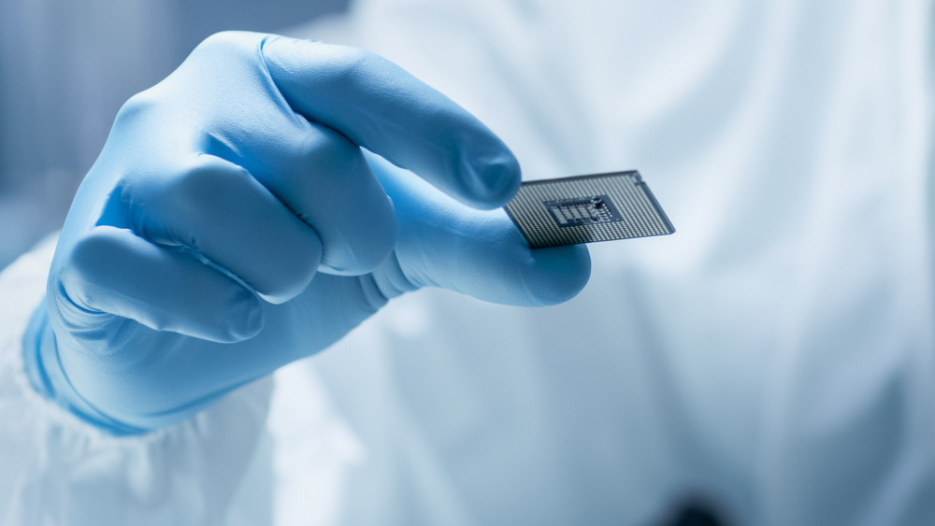
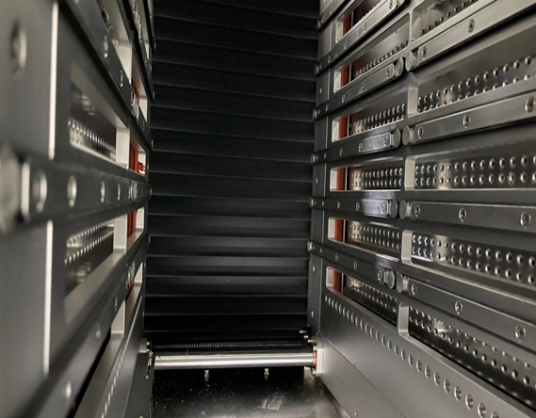
Drying | Hardening
High quality and reliablefunction of electronics
Hardening of coated printed circuit boards vertically with minimal space required
To ensure the reliability of these sensitive electronic sub-assemblies even in difficult
environmental conditions, a coat of paint is applied to the printed circuit board and then dried
in a special drying system. The coating protects the electronics from damage due to corrosion or other environmental influences such as moisture, chemicals and dust. It increases
the lifetime and quality of the product many times over. Alternatively, complete sub-assemblies are cast and encapsulated.
Vanstron Thermal Systems provides innovative drying and hardening procedures that meet every requirement. The latest development is a vertical drying system which offers maximum performance with minimal space required. All industries which implement painting processes and process sensitive sub-assemblies with a protective paint coating can benefit from this system.

Slide 3

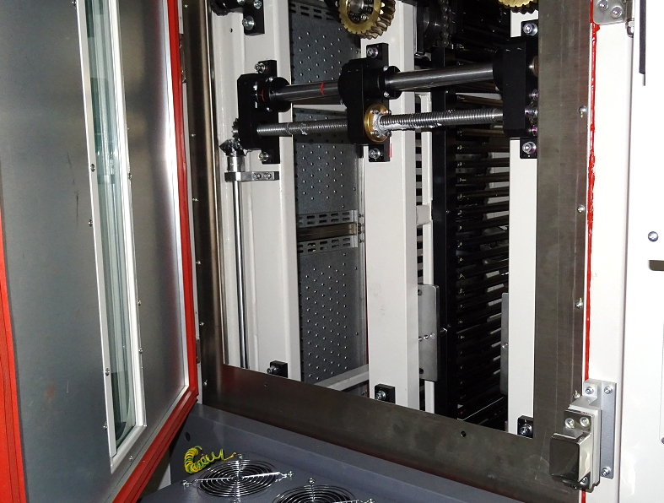
Drying | Hardening
Maximum performance in minimum space with equipment
In-line, vertical automation of the epoxy cure process produces immediate, significant benefits in three areas:
In-line automation increases productivity by eliminating the labor needed to load and unload batch ovens.
It improves process consistency, and therefore quality, by reducing the time and temperature variations caused by the frequent opening of batch oven doors.
And, as floor allocation costs rise on all factory floors... and particularly in clean rooms... a vertical format oven requires as little as 2.8㎡of floor space for cure cycles for a long time;
Good for Back End Semiconductor and PCB curing an underfill process;
Key features
Saves space through vertical transport principle
Targeted air feed in the heating zones for reproducible temperature profiles
Pre-heated supply air and the volume flow can be set for each heating zone
Minimal heat emission due to outstanding insulation
No thermal stress on the system mechanics due to external drive technology
Optimum accessibility of the system technology and easy maintenance

Slide 4

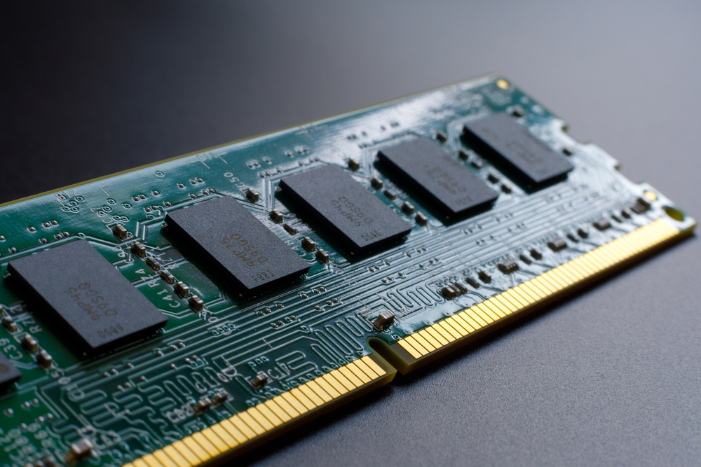

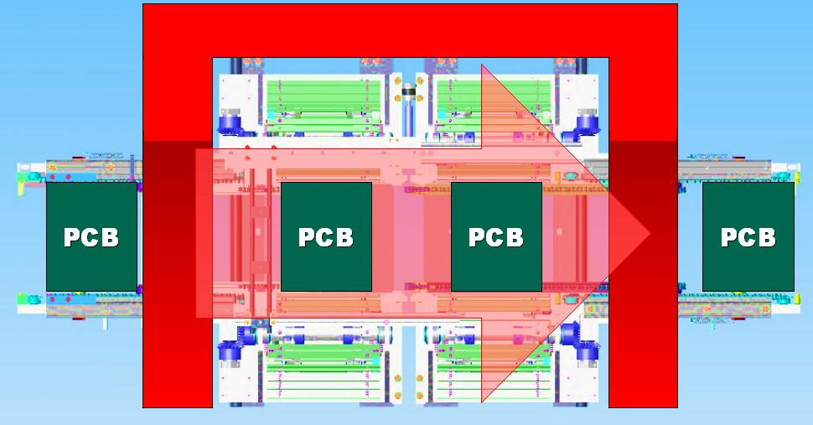
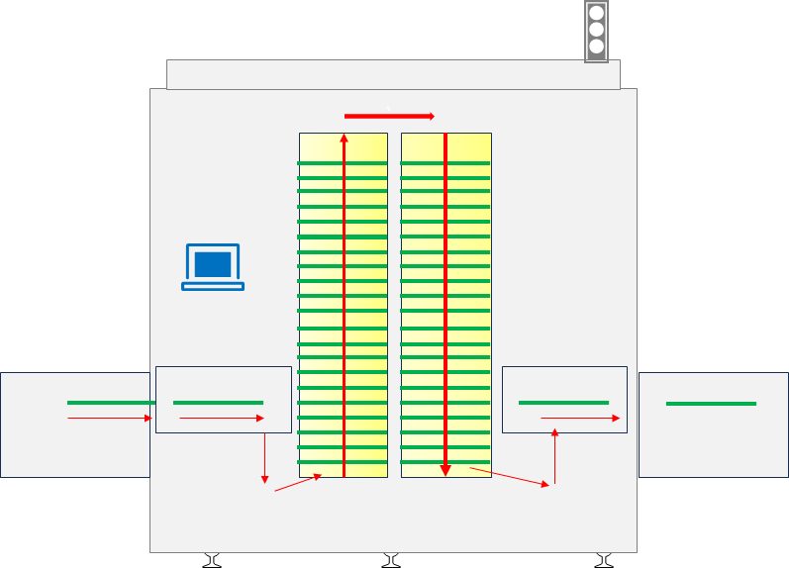
Drying | Hardening
Flexible transportation system allowed maximum 250°C temperature.
The Vertical buffer oven System not only offers ideal drying and hardening processes, it is also extremely compact and space-saving thanks to its design. As a result of the vertical transport, the systems replaces, with a system length of only around 2.35 m, a comparable 40 m long horizontal furnace. With the innovative system design, you can save valuable space in your production hall.
Flexible transport width, where the transport by means of circulating goods carriers is automatically set to the respective circuit board size Several painting lines can thus feed different products with different circuit board transport widths in the mix to the system. With the vertical buffer oven, printed circuit boards with a maximum height of 50 mm can be dried.
Transportation logical
Due to the reliable transportation technology, our conveyors is without the thermal stress on the system mechanics in the oven chamber air where there is the temperature degree reached maximum.250degree.
The optional conveyor is using the chain as the key transportation elements.

Slide 5
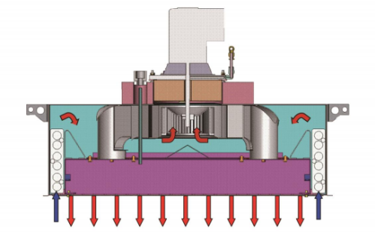

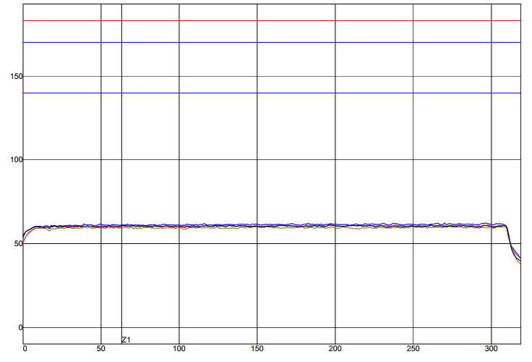
Drying | Hardening
Best profiling capability for reproducible procedures.
Using innovative control, blower, heating and sensor components combined with a solid machine design, Vanstron supplies a high-quality system enabling you to run and log stable processes in your production operations.
Return Air Flow returns into module through side suction holes and Outlet holes in grill are for convection gas flow only. All this improve our temperature stays constantly stable in the oven chamber and allows a good temperature uniformity.
Independent air velocity controlling system allows flexible processing control to easily handle complicated curing and drying process.
Provide Maximum heat capacity to rapidly reach temperature setting points at low rates of power consumption within a short period of time. The special process chamber design makes the air convection uniformly and temperature profile changeover easily.
Profile spikes per zone is eliminated with better zone segregation and decrease cross flow. The nozzle plate design allow to cover the boards with hot air in all direction for good uniformity.

Slide 6

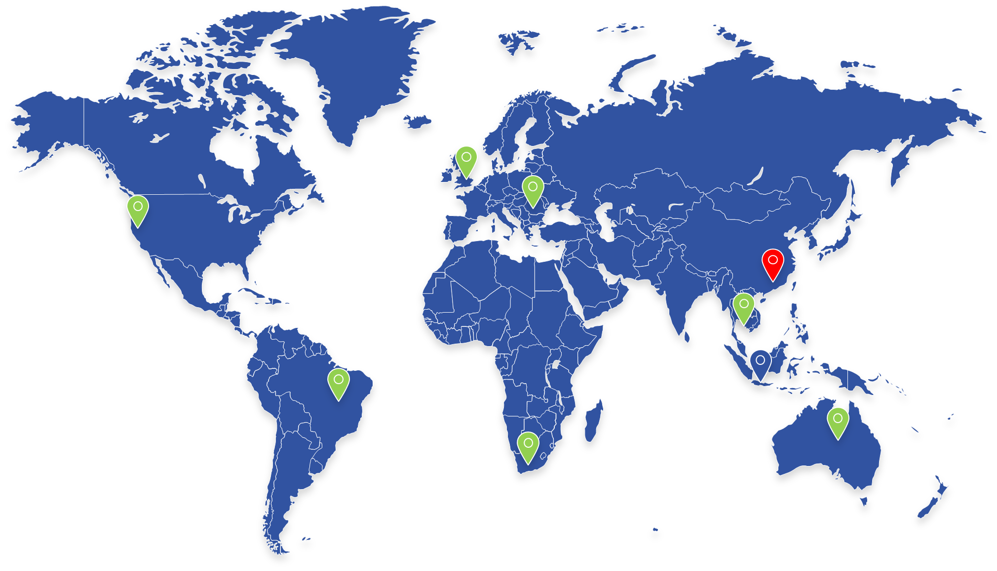
Technology Specifications
Products name & Model: VBH- series |  | Descriptions
Inline Drying / Curing oven- (Vertical Buffer type)
 | Model | VBH-250 | VBH-90
Standard Configuration | Heating system | 12 Heating module system ( Depends on different application)
 |  | Forced convection heating
 |  | Hot air speed adjusting by software;
 |  | Temperature uniformity across pallet: +/-2°C;
 |  | VBH-250 | VBH-90
 |  | Temperature effective range : Room temperature to Max.200°C; | Temperature effective range : Room temperature to Max.90°C;
 |  | Temperature control : PID closed loop control +SSR drive;
 | Transportation system | Conveyor direction: right to left
 |  | Conveyor heights:900mm+/-50mm
 |  | Conveyor width adjustable from 50*460mm
 |  | Max. length of product available: 50-500mm;
 |  | Conveyor width adjustments: automatic
 |  | Products components heights: customized solution
 |  | Buffer stock capacity: customized.
 |  | Per Boards keeping time in the oven programming by user
 |  | VBH-250 | VBH-90
 |  | Boards or pallet per weight: 5kg Max. | Boards or pallet per weight: 2.5kg Max
 |  | Pallet process edge distance:5mm (or specified)
 |  | Easy eye-level access to internal controls;
 |  | international standard SMEMA interface
 | Control system | PLC controller + touch screen software
 |  | -Temperature abnormal alarm
 |  | -Board dropped alarm system
 |  | -PID close loop temperature control
 |  | - Error diagnosis system;
 |  | - Operator password management
 |  | -SMEMA communication
 | Fume exhaust system | Standard exhaust system
 | Electrical system | -CE certificates supported; Power supply: 380 V ,3 Phase 50hz;

